Slide 1
Anaphylaxis in Pregnancy
<Enter date>

Slide 2
Housekeeping
Before we begin…

Slide 3
Today’s agenda
An overview of anaphylaxis in pregnancy
What is anaphylaxis?
Risk factors
Signs & symptoms
Management
After care
Notes:
This PowerPoint is an over view of recognition and management of anaphylaxis in pregnancy
What is anaphylaxis?
The risk factors associated with anaphylaxis.
The signs and symptoms of anaphylaxis.
The immediate management of anaphylaxis.
What is the after care following an anaphylaxis episode.

Slide 4
Overview
Rare but catastrophic complication both maternal & fetal
Respiratory
GI tract issues
Skin and mucosal involvement
Contractions – preterm labor
Back pain
Death
Notes:
Anaphylaxis is a rare event but it can be catastrophic to both the woman and her fetus.
Maternal:
respiratory problems; (e.g., wheeze, dyspnoea)
gastrointestinal issues; (e.g., vomiting, abdominal pain)
skin and mucosal involvement; (e.g., urticaria, itchy rash, swelling of lips)
cardiovascular and central nervous systems (e.g., reduced blood pressure, feeling faint, headache).
lower back pain
uterine cramps
preterm labour
valval or vaginal itching.
post traumatic stress
maternal death.
Fetal:
distress
hypoxia / anoxia
death – fresh stillbirth
Even though the rate of anaphylaxis is low there is significant morbidity and mortality.

Slide 5
Fetal issues
Distress
Hypoxia or Anoxia
Death, fresh still-birth

Slide 6
What is Anaphylaxis?
Serious generalised or systemic, allergic or hypersensitivity reaction
The immune system releases a flood of chemicals that can cause mild to severe response, even death
Symptoms usually occur within minutes of exposure to an allergen
Common triggers are foods, medications, insect bite & latex
Adrenalin maybe required
Notes:
What is a Anaphylaxis?
Anaphylaxis is defined as a serious, generalised or systemic, allergic or hypersensitivity reaction that can be life‐threatening or fatal.
Anaphylaxis causes your immune system to release a flood of chemicals that can cause you to go into shock — your blood pressure drops suddenly and your airways narrow, difficulty breathing. Signs and symptoms include a rapid, weak pulse; a skin rash and nausea and vomiting. Common triggers include certain foods, some medications, insect venom and latex.
Anaphylaxis requires an injection of adrenalin (epinephrine) and a follow-up trip to an emergency room. If you don't have epinephrine, you need to go to an emergency room immediately. If anaphylaxis isn't treated right away, it can be fatal.
Anaphylaxis symptoms usually occur within minutes of exposure to an allergen. Sometimes, however, it can occur a half-hour or longer after exposure.

Slide 7
Risk factors
Previous anaphylaxis
Allergies or asthma
Certain conditions
Notes:
Risk factors:
As with all situations clinicians need to risk assess throughout care to plan and mitigate against adverse outcomes.
There aren't many known risk factors for anaphylaxis, but some things that might increase your risk include:

Slide 8
Previous anaphylaxis
Once anaphylaxis occurs the risk of having this serious reaction again increases. Future reactions might be more severe than the first reaction.
Notes:
Previous anaphylaxis. If you've had anaphylaxis once, your risk of having this serious reaction increases. Future reactions might be more severe than the first reaction.

Slide 9
Allergies or asthma
People who have either condition are at increased risk of having anaphylaxis.
Notes:
Allergies or asthma. People who have either condition are at increased risk of having anaphylaxis.

Slide 10
Certain other conditions
These include heart disease and an abnormal accumulation of white blood cell (mastocytosis).
Notes:
Certain other conditions. These include heart disease and an abnormal accumulation of a certain type of white blood cell (mastocytosis).

Slide 11
Signs and symptoms
Skin reactions, including hives, itching and flushed or pale skin
Hypotension
Constriction of the airways, swollen tongue or throat, which can cause wheezing and trouble breathing
Weak and rapid pulse
Nausea, vomiting or diarrhoea
Dizziness or fainting
Notes:
Signs and symptoms of anaphylaxis:
The sign and symptoms of anaphylaxis can be inconsistent which makes diagnosis difficult.
Anaphylaxis symptoms usually occur within minutes of exposure to an allergen. Sometimes, however, it can occur a half-hour or longer after exposure.
Clinicians need to be vigilant when caring for a woman having new medications to detect changes that were not previously present.
Mild (grade 1)
Generalised mucocutaneous signs: Erythema, Urticaria +/- Angioedema (swelling around the eyes)
Moderate (Grade 2)
Multi-organ manifestation may include:
Hypotension, tachycardia
Evidence of bronchospasm, cough, difficulty breathing, difficult ventilation
Mucocutaneous signs
Life Threatening (Grade 3)
Life threatening & requires immediate & specific treatment
Severe hypotension
Bradycardia or tachycardia with arrhymias
Severe bronchospasm, and/or airway oedema
Cutaneous signs may be absent, or present only after correction of hypotension
Arrest (Grade 4)
Cardio pulmonary arrest

Slide 12
Signs and symptoms of Anaphylaxis

Slide 13

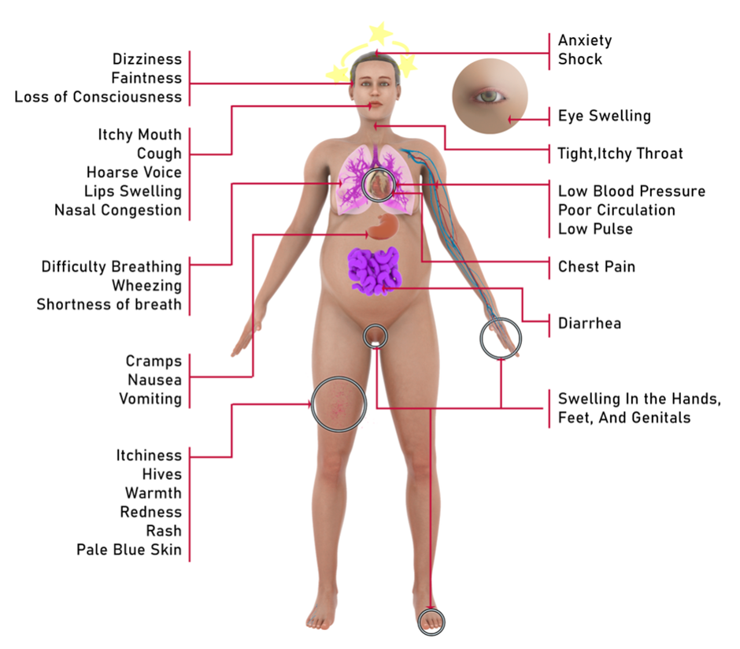

Slide 14
Pregnancy sign and symptoms
Fetal distress
Abdominal cramps
Pre-term labour
Backache
Valval and vaginal itching

Slide 15
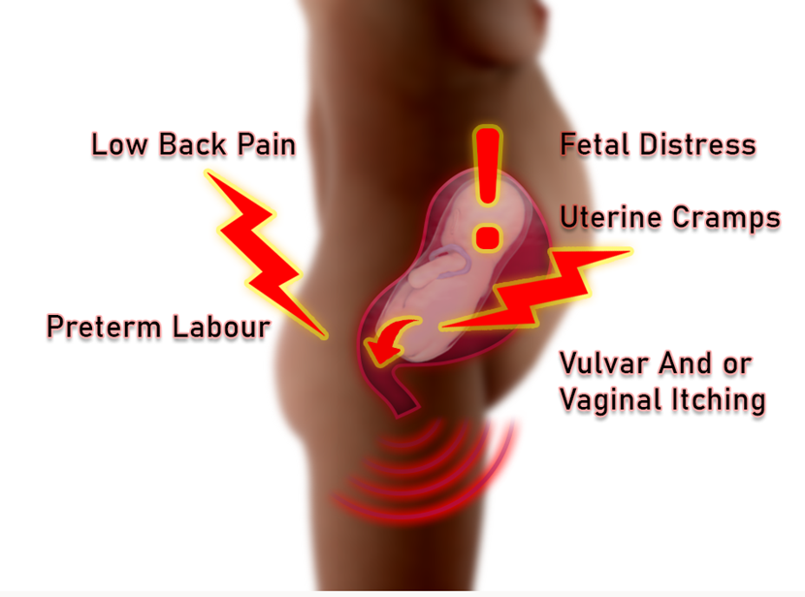

Slide 16
Managing Anaphylaxis
DR Danger & Diagnosis
S Send for help & organise teams, involve senior experts, obstetrician, anesthetics, midwifery, neonatal
AB Check or secure airway breathing – 100% oxygen
C Rapid fluid bolus, plan for large volume resuscitation
D Adrenaline bolus, repeated as needed, prepare infusion
Notes:
Management:
DR - Danger and Diagnosis, Response to stimulus
Unresponsive hypotension or bronchospasm
Remove triggers e.g. chlorhexidine, synthetic colloid
Stop procedure. Use minimal volatile if GA.
S - Send for help and organise team
Call for Help and Anaphylaxis box
Assign a designated Leader and Scribe
AB - Check/Secure Airway Breathing - 100% oxygen
Consider early intubation: airway oedema
Confirm FiO2 100%
C - Rapid fluid bolus Plan for large volume resuscitation
If hypotensive: Elevate legs
Bolus 2L Crystalloid, Repeat as needed
Large bore IV access. Warm IV fluids if possible
D - Adrenaline Bolus Repeat as needed Prepare Infusion
Initial I.V. Adrenaline Bolus (Adult)
Dilution 1 mg in 10 mL = 100 mcg/mL
Give dose below every 1-2 minutes prn
Increase dose if unresponsive
Moderate Life Threatening
(Grade 2)
20 mcg
= 0.2 mL
(Grade 3)
100-200 mcg
= 1-2 mL

Slide 17

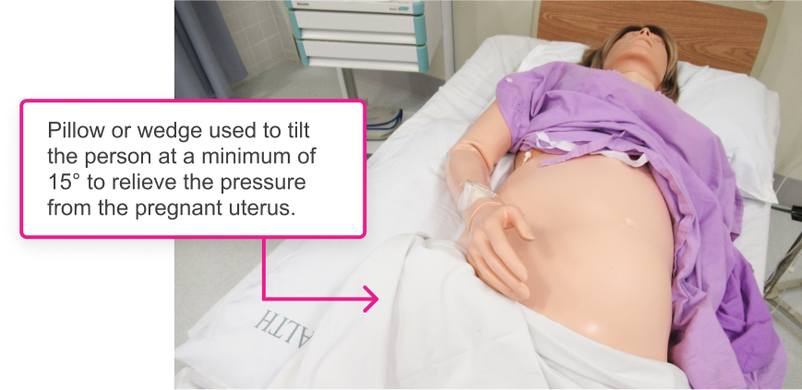
Managing Anaphylaxis
Notes:
Management
Left lateral 15° or more tilt
CTG – immediately to monitor fetus
Treat pre term labour after event
Pain relief
May require delivery if signs of fetal distress

Slide 18
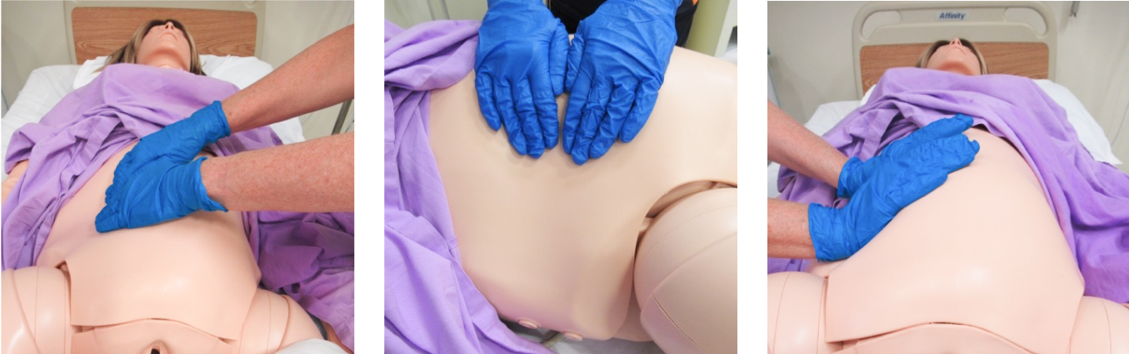
Manual displacement
Clinician displacing the uterus to the left manually.

Slide 19
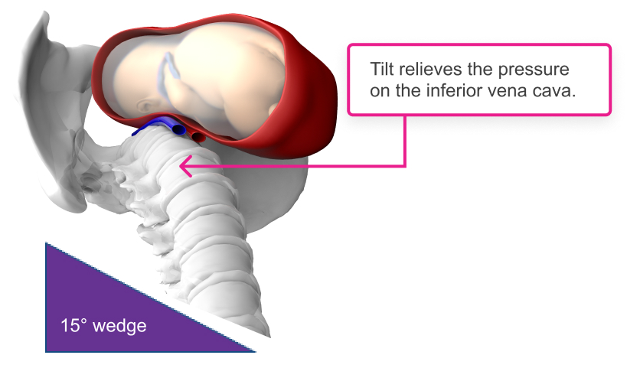
Manual displacement

Slide 20
After care
Depends on the severity – may need ongoing medication e.g. steroids
Consider oral antihistamines
Blood for Tryptase – 1 hour / 4 hour and > 24 hours
All other investigates as indicated
Monitor closely for 6 hours
May need ICU/ HDU admission
Anaphylaxis may persist for > 24 hours despite aggressive treatment
Notes:
After care:
Depends on the severity – they may need ongoing medication e.g. steroids – Dexamethasone 0.1 – 0.4mg/kg Hydrocortisone 2 – 4mg/kg
Consider oral antihistamines – when the patient is able to take oral medication
Blood for Tryptase – 1 hour/ 4hour & > 24 hours
Tryptase is an enzyme that is released, along with histamine and other chemicals, from mast cells when they are activated as part of a normal immune response as well as in allergic (hypersensitivity) responses.
Coagulation screen if going to OT for C/S
All other investigates as indicated – ECG, CXR, USS
Monitor closely for 6 hours – 1:1 care 1/2 hrly obs.
May need ICU / HDU admission
Anaphylaxis may persist for > 24 hours despite aggressive treatment so close observation

Slide 21
After care
Counselling around events
Document a clear plan in the medical notes for future clinicians to obtain, update allergies
Refer for testing and allergy assessment
Notes:
Counselling around events
Document a clear plan in the medical notes for future clinicians to obtain, update allergies
Refer for testing and allergy assessment

Slide 22
References
1. Australasian Society of Clinical Immunology and Allergy. Acute Management of Anaphylaxis Guidelines. 2019.
2. Australian & New Zealand Anaesthetic Allergy Group. ANZAAG Anaphylaxis Management Guidelines [Internet]. 2016 [cited 2021 Jul 18]. Available from: http://www.anzaag.com/Mgmt Resources.aspx
3. Australian Resuscitation Council. The ARC Guideliens [Internet]. [cited 2021 Jul 18]. Available from: https://resus.org.au/guidelines/

Slide 23

Share your feedback

